Slide 1
Northrop Grumman:
Secure State Estimation
HMC Team:
Robert Cyprus (S)
Aishvarya Korde (S)
Zayra Lobo (J)
Paige Rinnert (Fall TL)
Advisor: Professor Chris Clark
Liaisons: Ken Dreshfield ‘80
Ian Jimenez ‘11
Ron P. Smith ‘83
Stephanie Tsuei (Lead)
Notes:
Zayra, reading and not presenting – only thing to read is problem statement. Look at the audience

Slide 2
Notes:
This slide is basic – we need to sell, not report.. Maybe change overview slide

Slide 3
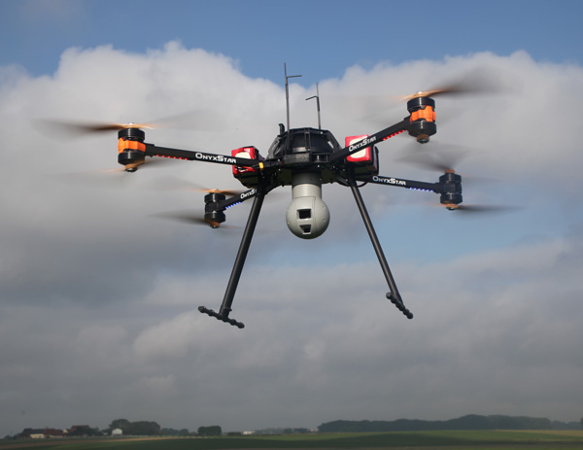
Overview
Project Description
Theory
Hardware
Current Progress
Questions
https://en.wikipedia.org/wiki/Quadcopter
Notes:
This slide is basic – we need to sell, not report.. Maybe change overview slide

Slide 4


Project Statement
The Northrop Grumman Clinic Team will implement a secure state estimator in software and then experimentally validate the estimator in hardware. The team will demonstrate that the addition of the SSE algorithm to the control loop reduces the real-time tracking error of a quadrotor when using measurements from compromised onboard sensors.
Notes:
Show quadrotors and maybe not the logos – make sure not to read these slides

Slide 5
Project Statement
The Northrop Grumman Clinic Team will implement a secure state estimator in software and then experimentally validate the estimator in hardware. The team will demonstrate that the addition of the SSE algorithm to the control loop reduces the real-time tracking error of a quadrotor when using measurements from compromised onboard sensors.

Slide 6
Project Statement
The Northrop Grumman Clinic Team will implement a secure state estimator in software and then experimentally validate the estimator in hardware. The team will demonstrate that the addition of the SSE algorithm to the control loop reduces the real-time tracking error of a quadrotor when using measurements from compromised onboard sensors.

Slide 7
Project Statement
The Northrop Grumman Clinic Team will implement a secure state estimator in software and then experimentally validate the estimator in hardware. The team will demonstrate that the addition of the SSE algorithm to the control loop reduces the real-time tracking error of a quadrotor when using measurements from compromised onboard sensors.

Slide 8
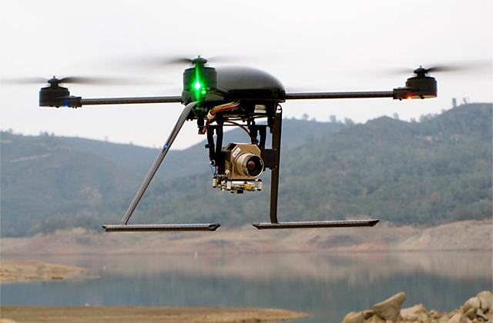
Objectives
Demonstrate quadrotor altitude tracking control with minimal tracking error [m]
Maximize the number of compromised sensors for which the SSE can be tested
Minimize cost
http://illumin.usc.edu/162/the-quadrotors-coming-of-age/
Notes:
Make a picture of UAV trying to maintain altitude
Audience isn’t sure what “max num of comp sensors” means yet…

Slide 9
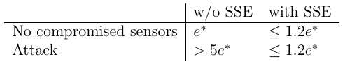
Constraints
SSE must reduce tracking error when sensors are compromised:
Final implementation of the SSE must be in ROS
Quadrotor must fly for 10 minutes on a single battery charge
Must estimate states at a frequency of at least 25 Hz

Slide 10
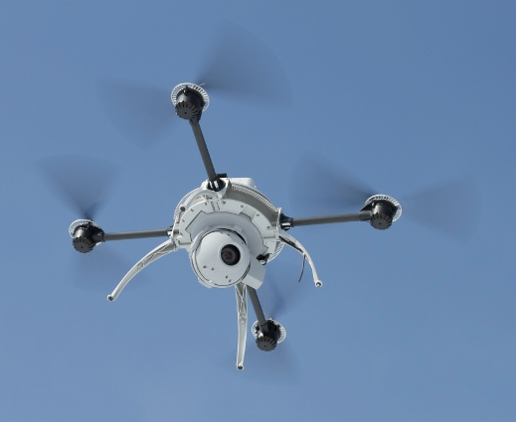
Functions
Quadrotor should complete pre-planned altitude profile with compromised sensors
Quadrotor should perform real time state estimation and correction
The team must be able simulate hacking of sensor inputs to the SSE
The SSE should estimate the state of the quadrotor (position [m], velocity [m/sec], orientation [°], angular velocity [°/sec])
http://spectrum.ieee.org/automaton/robotics/military-robots/aeryon-scout-quadrotor-spies-on-bad-guys-from-above
Notes:
Too many words – ended up reading this
We don’t know what estimate the state means… Explain this

Slide 11
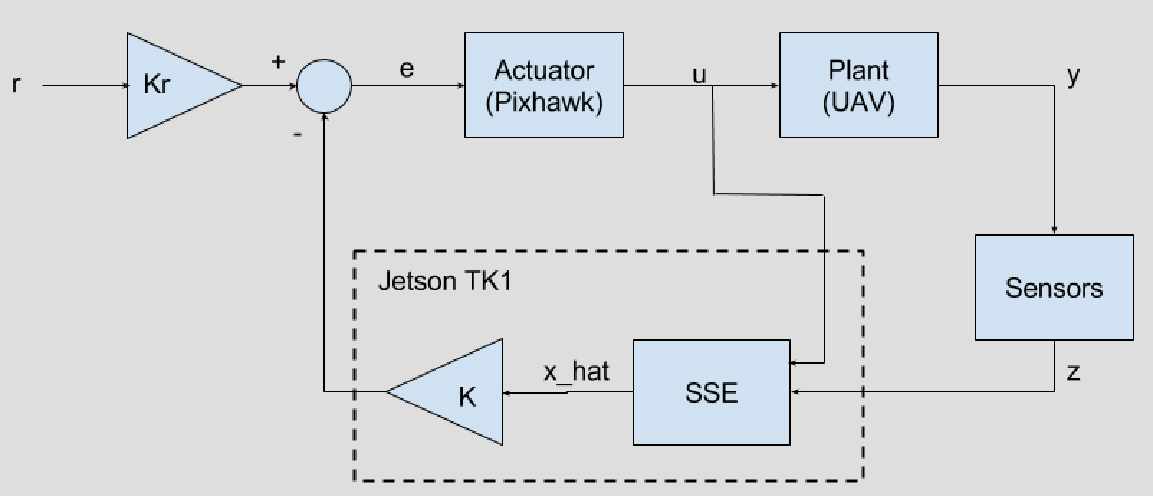
Preliminary Control System Outline
Notes:
Transition – recap the problem statement and big picture (same with Robert on trans to hardware)

Slide 12
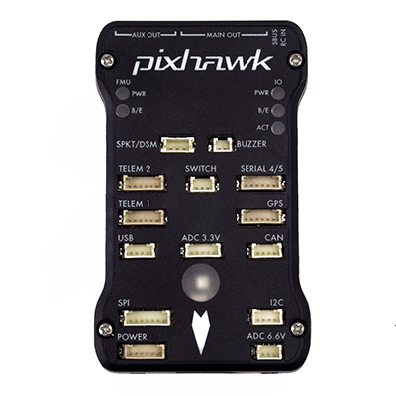
Preliminary Control System Outline
Notes:
Transition – recap the problem statement and big picture (same with Robert on trans to hardware)

Slide 13
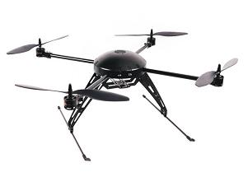
Preliminary Control System Outline
http://www.pupin.rs/RnDProfile/research-topic28.html
Notes:
Transition – recap the problem statement and big picture (same with Robert on trans to hardware)

Slide 14
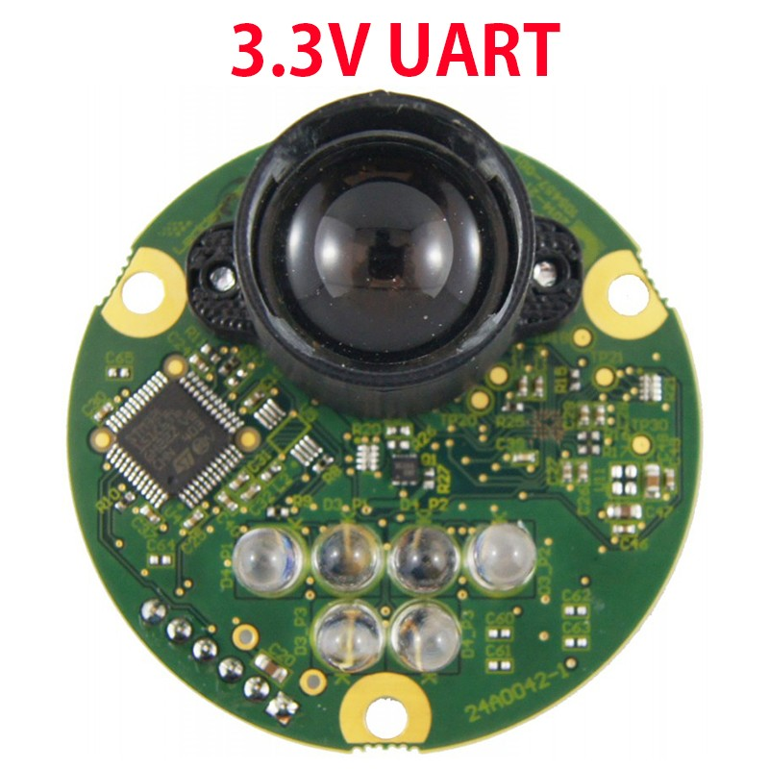
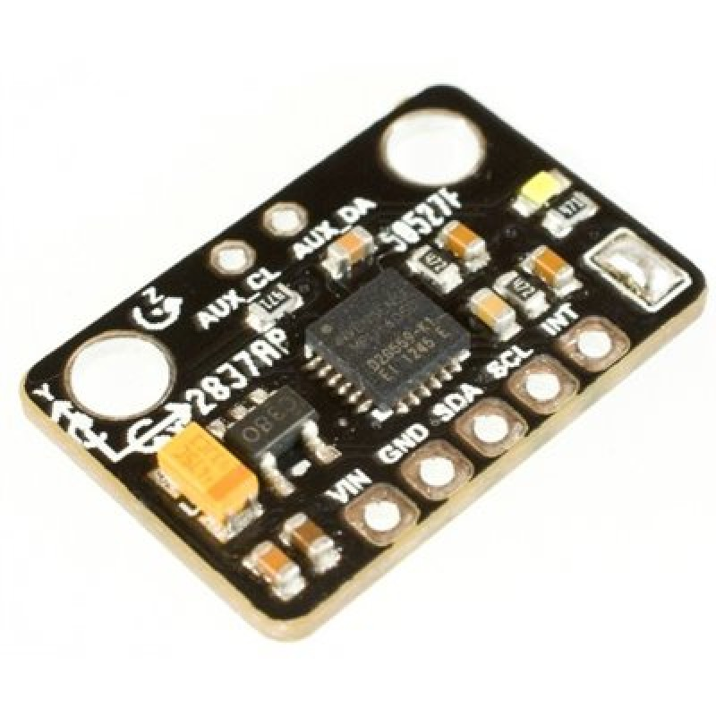
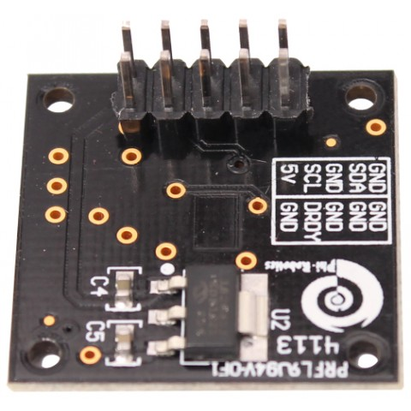
Preliminary Control System Outline
Notes:
Transition – recap the problem statement and big picture (same with Robert on trans to hardware)

Slide 15
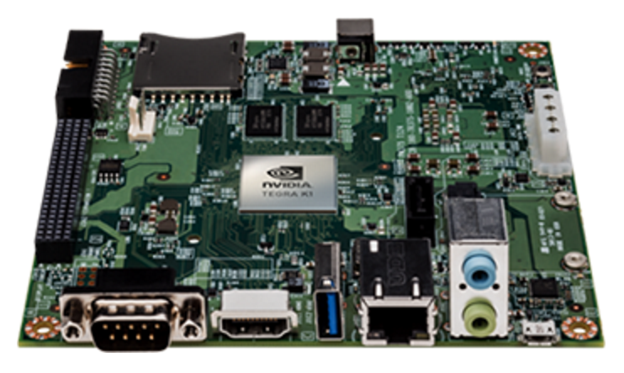
Preliminary Control System Outline
http://www.pupin.rs/RnDProfile/research-topic28.html
Notes:
Transition – recap the problem statement and big picture (same with Robert on trans to hardware)

Slide 16
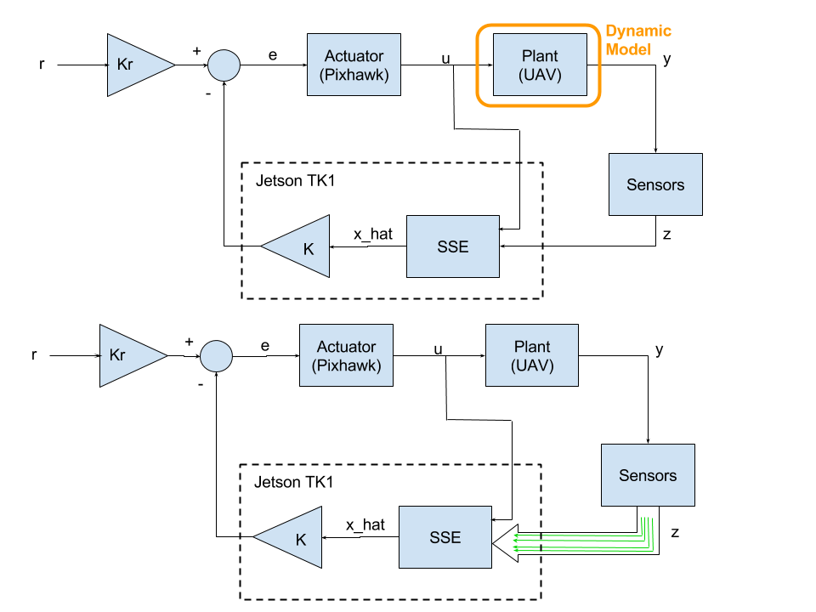
Preliminary Control System Outline
Functioning Sensors

Slide 17
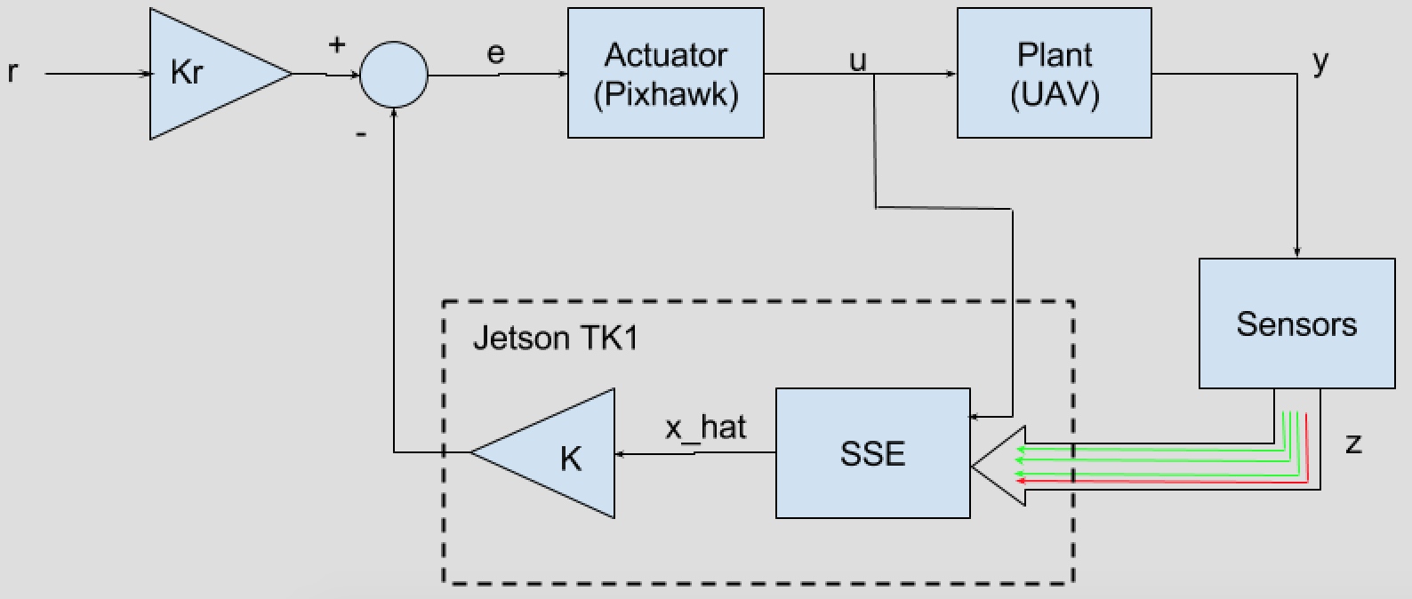
Preliminary Control System Outline
Functioning Sensors
Compromised Sensors

Slide 18
Preliminary Control System Outline
Dynamic Model
http://www.pupin.rs/RnDProfile/research-topic28.html
Notes:
Transition – recap the problem statement and big picture (same with Robert on trans to hardware)

Slide 19
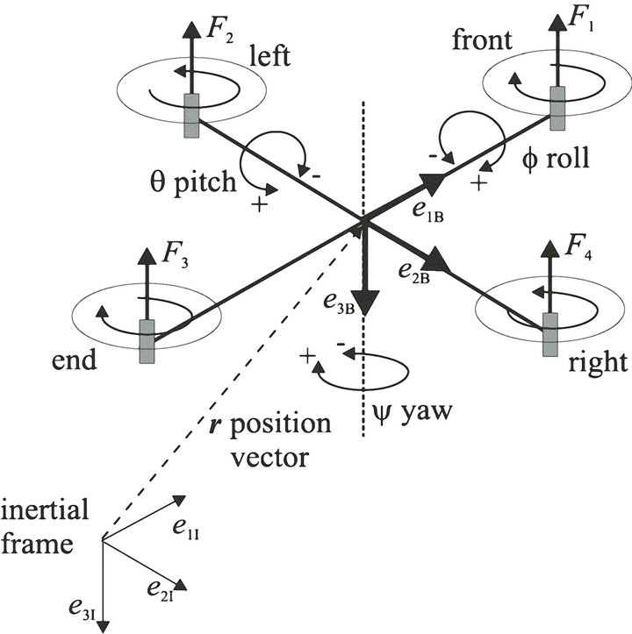
Quadrotor Dynamic Model: Coordinate Definitions
Body frame
http://file.scirp.org/Html/12-7900231_35654.htm
Notes:
Transition again, talk about big picture, then get into the details
We need a dymanic model to test a simulator
Split into multiple slides
Possibly an intro slide set, before the problem statement

Slide 20
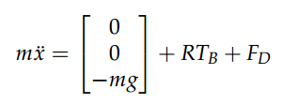
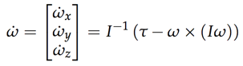
Dynamic Model
 | Thrust vector in body frame
 | Drag force
 | Rotation matrix (linear)
 | Inertia matrix
 | Torques in body frame
 | Angular velocity
 | Rotation matrix (rotational)
Linear Motion
Rotational Motion
http://andrew.gibiansky.com/downloads/pdf/Quadcopter%20Dynamics,%20Simulation,%20and%20Control.pdf

Slide 21
Preliminary Control System Outline: SSE
Optimization Algorithm

Slide 22
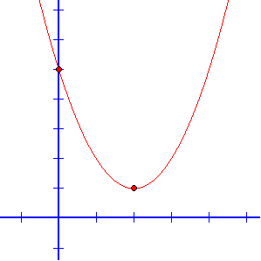
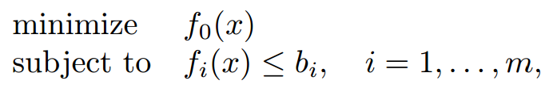
Convex Optimization
Solves special class of problems
Least-squares linear programming (LP)
Quadratic programming (QP)
Many solvers exist (e.g. CVX)
Fast solution time
http://stanford.edu/~boyd/papers/pdf/rt_cvx_sig_proc.pdf
Notes:
Transition statement
Really tough to make interesting

Slide 23
Convex Optimization Example
http://stanford.edu/~boyd/papers/pdf/rt_cvx_sig_proc.pdf
http://www.mesacc.edu/~scotz47781/mat120/notes/graph_quads/vertex_form/graph_quads_vertex_form.html
Notes:
Transition statement
Really tough to make interesting

Slide 24
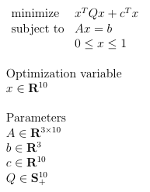
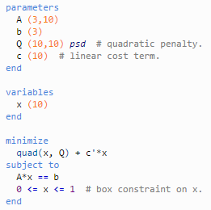
Optimization Example - Quadratic Programming
Mathematical representation:
CVX code (CVXgen):
Notes:
Get across the point: once in math form, we can code it up
Getting a real-life example would be ideal… Real world -> math -> CVX

Slide 25
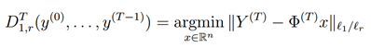
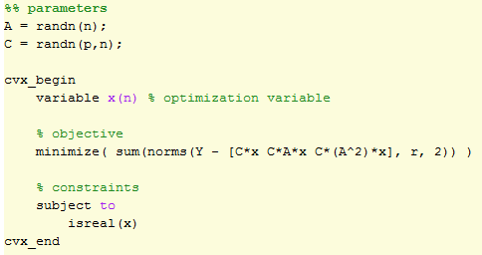
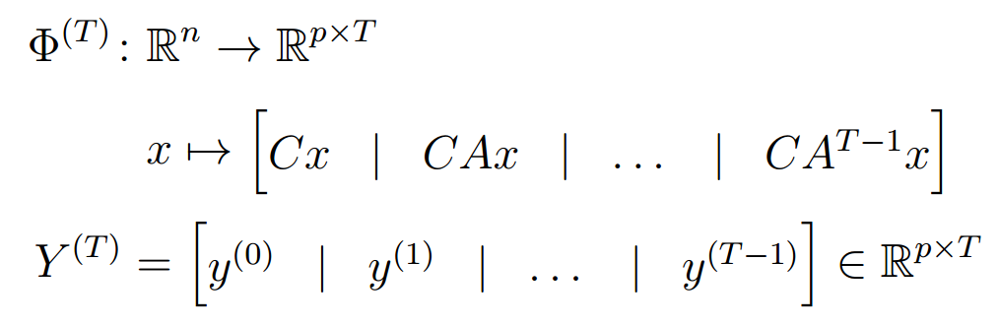
SSE Optimization Algorithm
Mathematical representation:
CVX code:
Hamza Fawzi, Paulo Tabuada, Suhas Diggavi, Secure estimation and control for cyber-physical systems under adversarial attacks
Implementing SSE algorithm in Matlab
Working on using CVXgen to generate solver code
Notes:
CHANGE the “functioning” part in Matlab – just get rid of

Slide 26
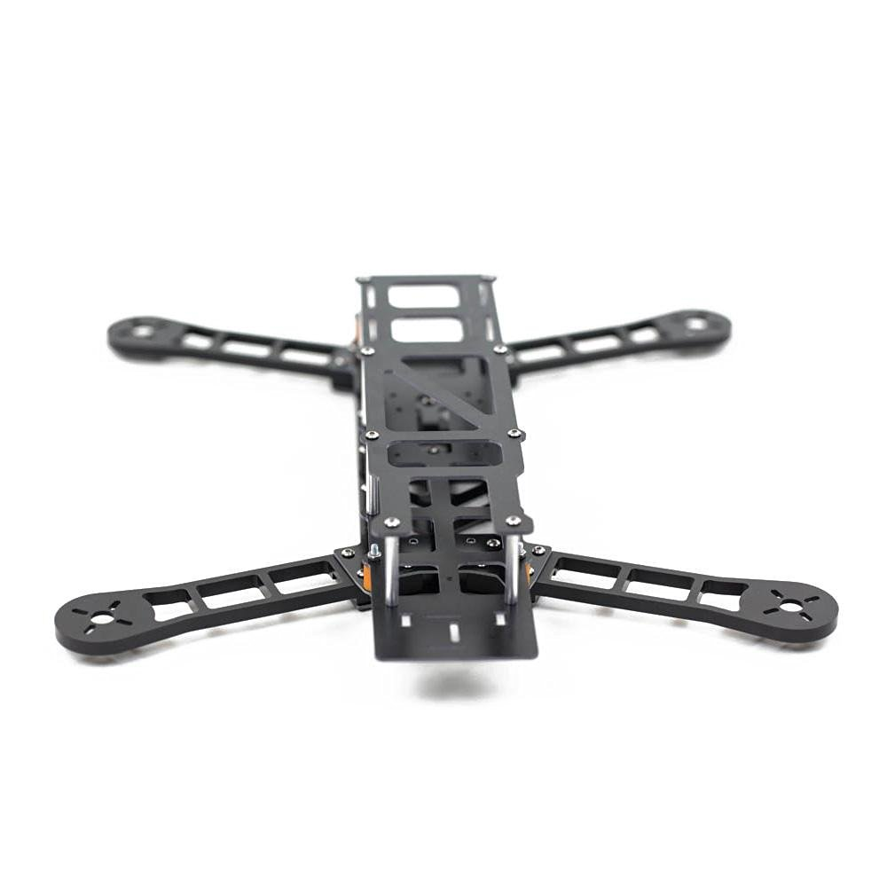
Hardware: Quadrotor and Control
Onboard computer
Jetson TK1 board
Flight controller
3DR Pixhawk
Quadrotor frame
QAV400
Lightweight
Easily customizable
http://www.nvidia.com/object/jetson-tk1-embedded-dev-kit.html
http://www.desertaircraft.com.au/shop/qav400-fpv-quadcopter-frame-arf.html
http://www.hover-bike.com/MA/product/pixhawk/

Slide 27
Hardware: Sensors
3-DOF Position/Velocity
Accelerometers
Laser Range Finder
OptiTrack vision system
3-DOF Orientation/Angular Velocity
Compass
Gyroscopes
Notes:
Transition statement
Talk about what each sensor will give you
This slide shows research, but doesn’t show what this is useful for
Draw pictures of UAV with sensors on it

Slide 28
Hardware: Sensors
3-DOF Position/Velocity
Accelerometers
Laser Range Finder
OptiTrack vision system
3-DOF Orientation/Angular Velocity
Compass
Gyroscopes
IMU (3 accelerometers & 3 gyroscopes)
Notes:
Transition statement
Talk about what each sensor will give you
This slide shows research, but doesn’t show what this is useful for
Draw pictures of UAV with sensors on it

Slide 29
Hardware: Sensors
3-DOF Position/Velocity
Accelerometers
Laser Range Finder
OptiTrack vision system
3-DOF Orientation/Angular Velocity
Compass
Gyroscopes
Laser Range Finder
Height z
Notes:
Transition statement
Talk about what each sensor will give you
This slide shows research, but doesn’t show what this is useful for
Draw pictures of UAV with sensors on it

Slide 30
Hardware: Sensors
3-DOF Position/Velocity
Accelerometers
Laser Range Finder
OptiTrack vision system
3-DOF Orientation/Angular Velocity
Compass
Gyroscopes
Compass
Notes:
Transition statement
Talk about what each sensor will give you
This slide shows research, but doesn’t show what this is useful for
Draw pictures of UAV with sensors on it

Slide 31
Hardware: Sensors
3-DOF Position/Velocity | 3-DOF Orientation/Angular Velocity
Accelerometers Laser Range Finder OptiTrack Vision System | Compass Gyroscopes
Laser Range Finder
IMU (3 accelerometers & 3 gyroscopes)
Compass
Notes:
Transition statement
Talk about what each sensor will give you
This slide shows research, but doesn’t show what this is useful for
Draw pictures of UAV with sensors on it

Slide 32
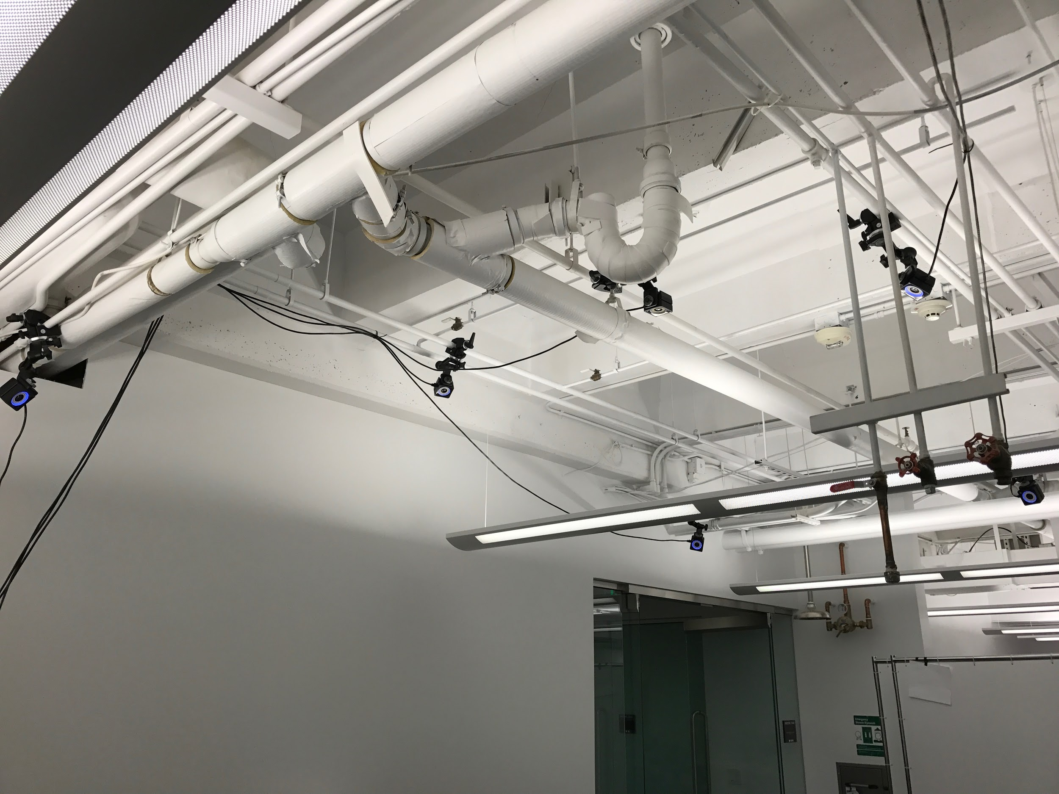
Optitrack Motive: Camera Positions

Slide 33
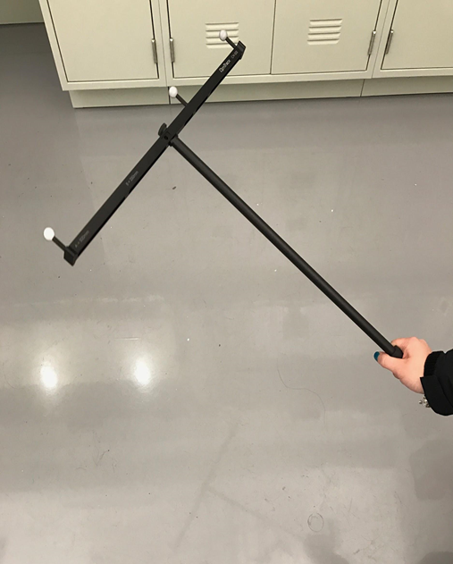
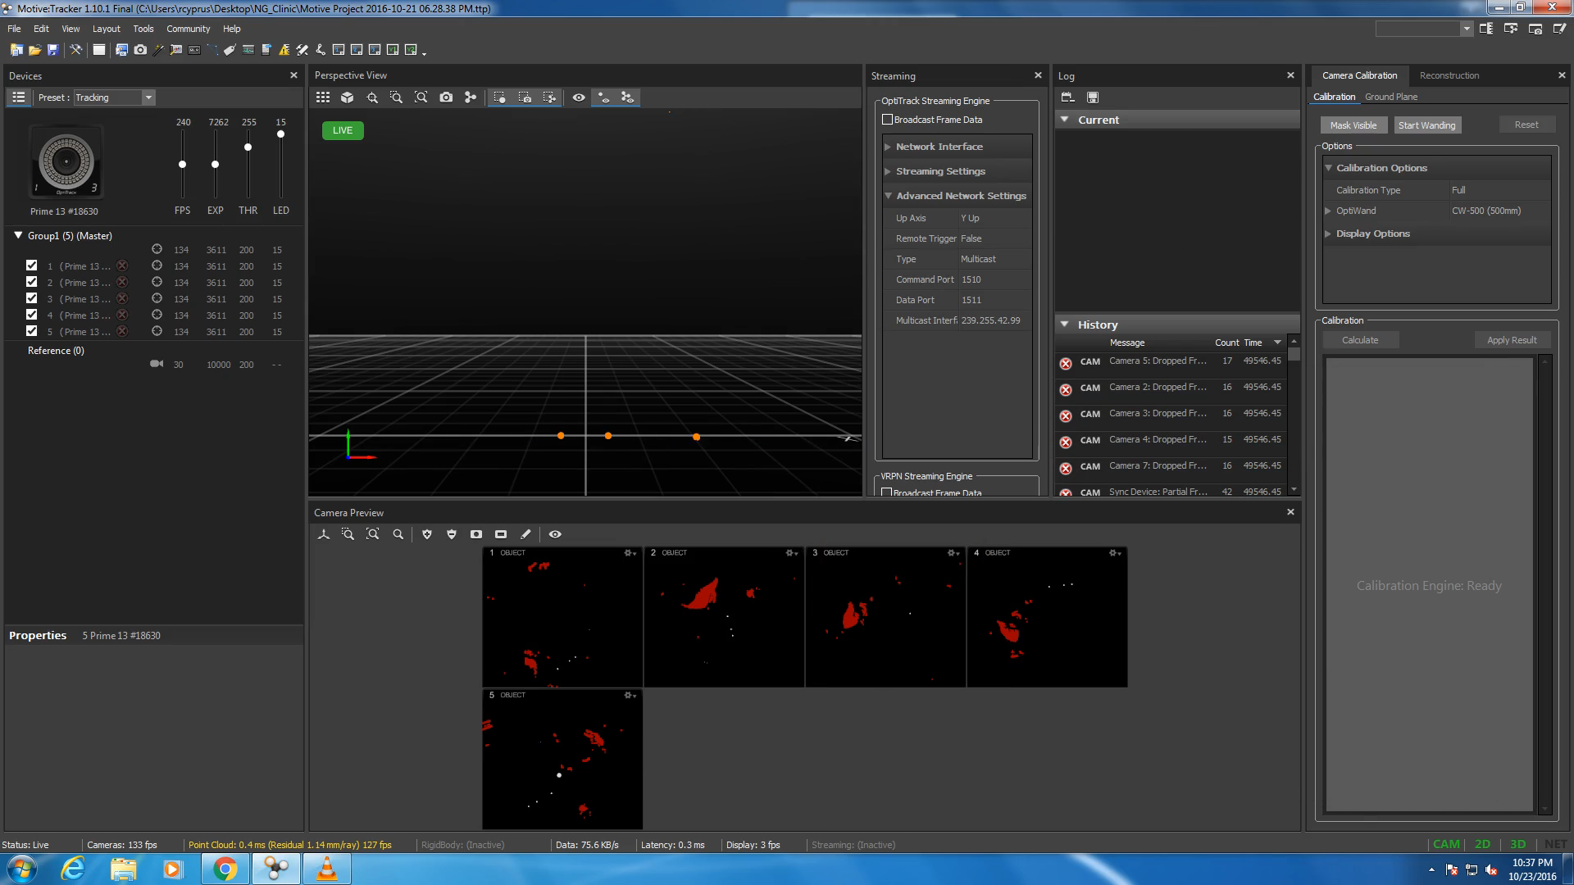
Optitrack System: Example Tracking
Notes:
Tell them what to expect before playing the video
Put circles around the IR spheres in the left pic

Slide 34
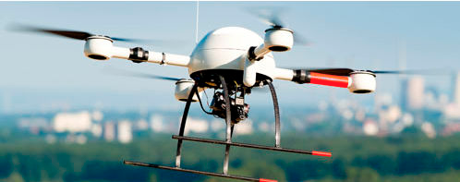
Deliverables
Fall Semester
Implement and simulate a state estimator in Matlab
All sensors functioning
Some sensors compromised
Successfully log sensor data
Produce a functioning quadrotor with onboard computer, controller, and sensors
Spring Semester
Test state estimator on real sensor data
Some corrupted measurements
Offline and in real time
Demonstrate quadrotor flight with real time data logging and state estimation
http://zacharytylerpoole.blogspot.com/2013/09/personal-uavs-for-public-use.html
Notes:
Put this at the end

Slide 35
Current Progress and Short Term Goals
Current progress
Completed workplan
Purchased controller, onboard computer and sensors
Setup and calibrated OptiTrack vision system
Short-term goals
Purchase quadrotor
Quadrotor dynamic model simulation
Continue to improve SSE algorithm in Matlab
Calibrate sensors
Notes:
Add a plot or pic

Slide 36
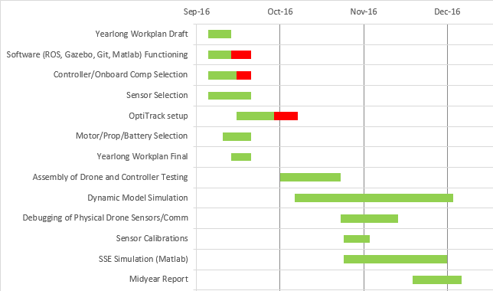
Current Progress - Fall semester Gantt chart

Slide 37
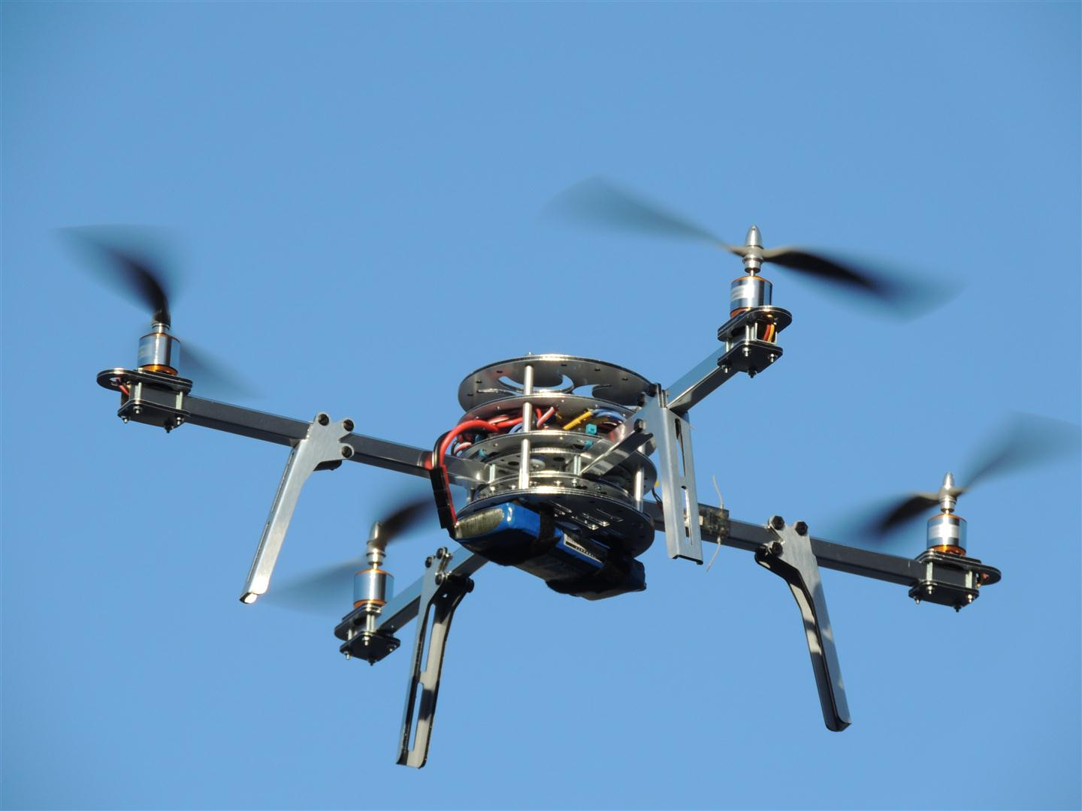
Questions?
http://technozion.org/tz15/home/events/quadcopter

Slide 38
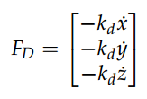
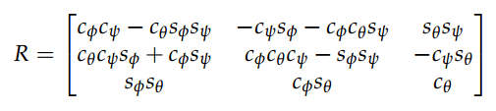
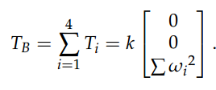
Linear Motion
Drag Force
Rotation matrix for relating body frame to inertial frame
Thrust vector in body frame
http://andrew.gibiansky.com/downloads/pdf/Quadcopter%20Dynamics,%20Simulation,%20and%20Control.pdf

Slide 39
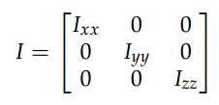
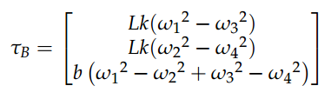
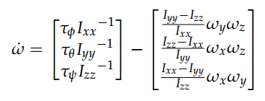
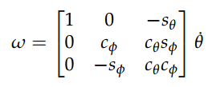
Rotational Motion
Inertia matrix
Torques in the body frame
Angular velocity in body frame
Rotation matrix for relating body frame to inertial frame for rotational motion
http://andrew.gibiansky.com/downloads/pdf/Quadcopter%20Dynamics,%20Simulation,%20and%20Control.pdf

